Slide 1
Remote Work & Mental Health In North America
Hannah Chappell

Slide 2
Business Context
Since COVID remote work has become the norm. It’s important to understand the impact it has on employee’s mental well-being with this change.
While it offers flexibility and reduces commute stress, it also blurs the lines between work and personal life. Without a proper work-life balance this can lead to increased feelings of isolation, burnout, anxiety, etc.
Business Question: How does remote work affect mental health?

Slide 3
Data Overview
The dataset used is from Kaggle.
A survey was conducted and collected 5,000 responses globally from individuals with different industry backgrounds.
The dataset looks into how remote work affects employees mental well-being, stress levels, and mental health conditions.
The key variables I used for my research are Industry, Work Location, Work Life Balance Rating, Stress Level, Mental Health Condition, and Satisfaction with Remote Work.

Slide 4
Data Cleaning & Wrangling
In terms of cleaning, the dataset has already been cleaned when I first started working with it.
After getting the DataFrame details, there were over 5,000 entries and narrowed down to entries only in North America which became 777 entries.
Double checked for duplicates.
Checked for any Null values. Null values were found in Mental_Health_Condition and Physical_Activity columns. Since I am using the Mental_Health_Condition column for my research, I converted the Null values to None.

Slide 5
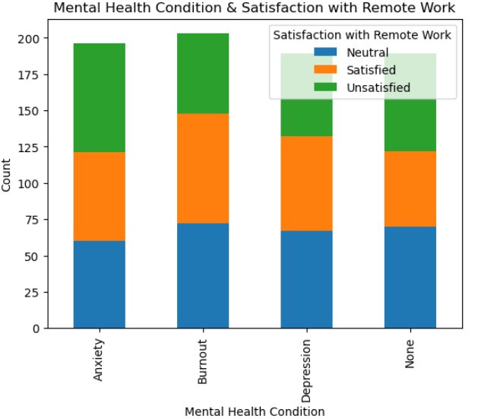
Mental Health Conditions & Satisfaction with Remote Work
Anxiety and No Mental Health Condition: Both groups have a higher count of unsatisfied individuals compared to those with burnout and depression.
Consistent Neutral Levels: Regardless of mental health conditions, the number of individuals who are neutral seem relatively consistent across all groups.

Slide 6
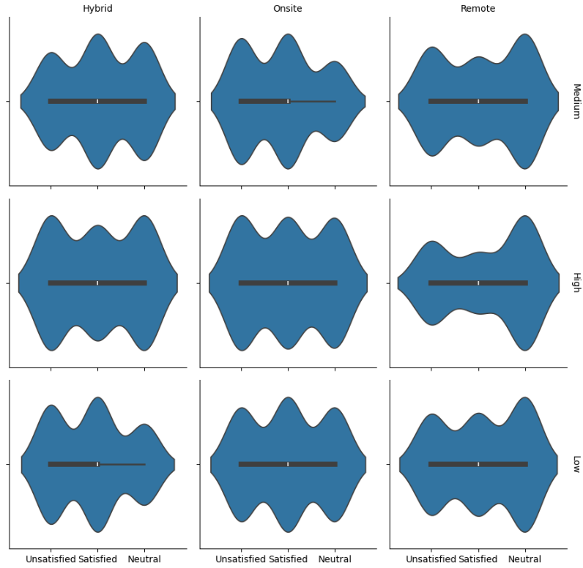
Remote Work Satisfaction vs. Location and Stress Level
Notes:
High Stress = Unsatisfied: Across all work arrangements, high-stress individuals tend to be unsatisfied with hybrid and onsite.
Low Stress = Satisfied: Those with low stress levels are generally satisfied, especially in remote work settings.
Medium Stress: Shows a balanced distribution, but with a tendency to skew toward neutral for remote.

Slide 7
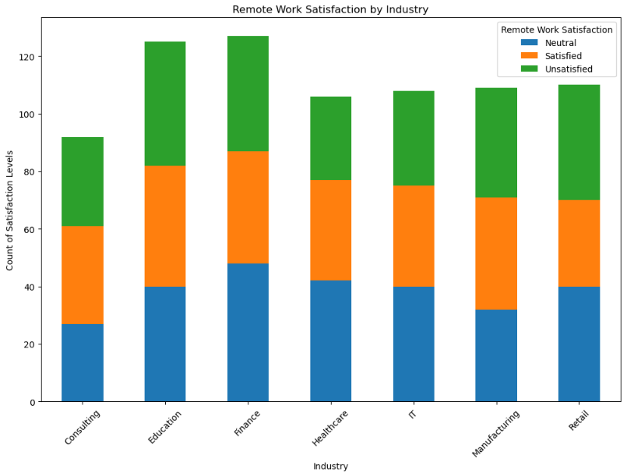
Remote Work Satisfaction by Industry
Consulting: Balanced distribution among Neutral, Satisfied, and Unsatisfied levels, with the lowest overall counts compared to other industries.
Education: Highest counts of remote work satisfaction levels.
Finance: High counts across the board, with a significant portion being satisfied and unsatisfied.
Healthcare, IT, Manufacturing, and Retail: Similar counts among the four industries,patterns of satisfaction levels are more evenly distributed, with notable counts in satisfied and unsatisfied categories.

Slide 8
The End

